Slide 1
Lec. No. 1
Safety in the microbiological laboratory, Demonstration of laboratory equipment's, their basic functions and handling
Prof.
Dr. Rasha M. Othman
Assist. Lec.
Nada S. Hadi

Slide 2
Some definitions:
Biosafety: The technologies and practices that are implemented to prevent the unintentional exposure to pathogens and toxins.
Biohazard: An agent of biological origin that has the capacity to produce deleterious effects on humans, i.e. microorganisms, toxins and allergens derived from those organisms.

Slide 3



Biohazard symbol ‎
A symbol that is universally recognized as a warning against substances that pose a threat to the health of living organisms, primarily that of humans.

Slide 4

Classification of infective microorganisms by risk group
Risk Group 1 (no or very low individual and community risk)
A microorganism that is unlikely to cause human or animal disease.
Risk Group 2 (moderate individual risk, low community risk)
A pathogen that can cause human or animal disease but is unlikely to be a serious hazard
Risk Group 3 (high individual risk, low community risk)
A pathogen that usually causes serious human or animal disease but does not ordinarily spread from one infected individual to another.
Risk Group 4 (high individual and community risk)
A pathogen that usually causes serious human or animal disease and that can be readily transmitted from one individual to another

Slide 5
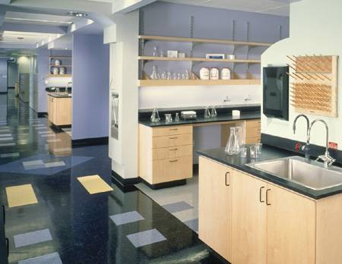
Risk Group 1
Unlikely to cause animal or human disease
Non pathogenic agent
Examples:
E.coli (non‐pathogenic strains),
yeast
Requirements:
Labs must have doors and sinks for hand washing
Work surfaces must be easy to clean

Slide 6
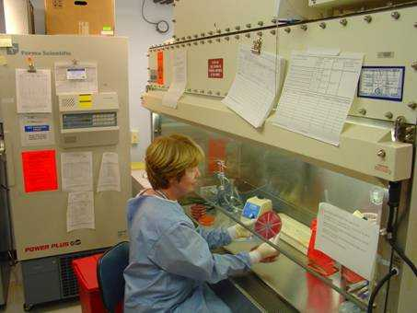
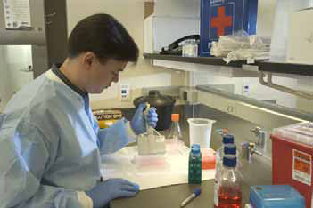
Risk Group 2
Pathogenic for humans
Treatment and preventive measures available
Limited risk of spread of infection
Examples:
Measles, Salmonella, Hepatitis B
Requirements:
Doors can be locked, limited access
Directional airflow (no air circulating into other labs)
Some procedures conducted in biological safety cabinets

Slide 7
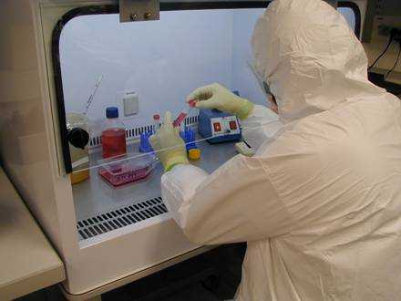
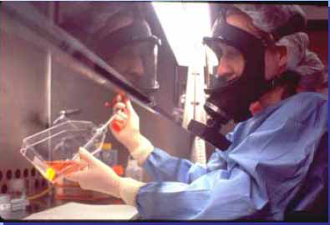
Risk Group 3
Pathogenic, cause serious disease
Effective treatment and preventive measures usually available
Little person-to-person spread
Examples:
Tuberculosis, Hepatitis C, HIV
Requirements:
Separate building or isolated zone
Double entry door
Respiratory protection when necessary

Slide 8
Risk Group 4
Lethal, pathogenic agent
Readily transmissible : direct, indirect
Effective treatment and preventive measures not usually available
Examples:
Ebola, Smallpox
Requirements:
Dedicated exhaust and vacuum system
Door, windows, etc. are sealed
Emergency breathing air, generator and exit
Special personnel suit
Level 4 labs are rare!
National Institute for Infectious
Diseases, Rome, Italy

Slide 9
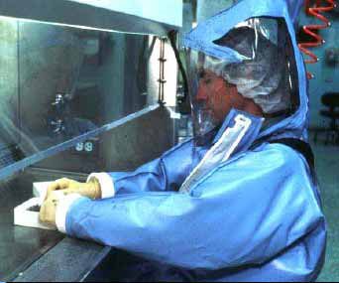
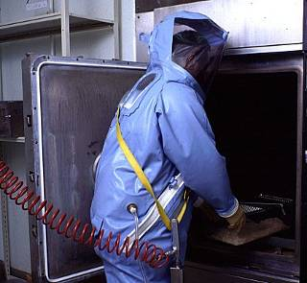
Risk Group 4

Slide 10
Why does it matter?
Safe working protects:
  You
  Other lab workers
  Cleaners
  Visitors
  Your work

Slide 11
Basic principles for biosafety:
Personal protection
Procedures

Slide 12
Personal protection:
Read instructions carefully before attempting to do anything.
Never do unauthorized experiments and never work alone in laboratory especially when hazardous operations are conducted.
Know the location of safety equipment and emergency procedures in your area.
Do not use or store highly flammable solvents near electrical equipment.
Notify your supervisor if any accident occurs.

Slide 13
Personal protection:
Always wear laboratory coat, eye protection and gloves.
Do not wear laboratory clothing outside the laboratory.
Do not wear open toe shoes.
Wear mask to avoid possible exposure to chemical powders.
Wash hands with water and soap after handling with infectious materials and before leaving the laboratory.
Never eat, smoke, drink, handling of contact lenses or apply cosmetics in the laboratory

Slide 14
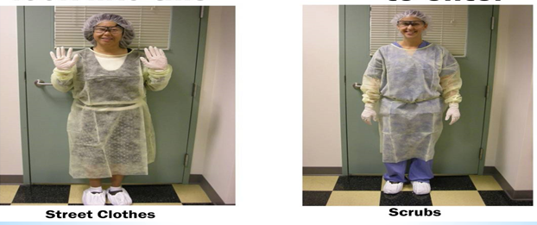
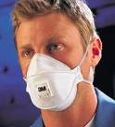
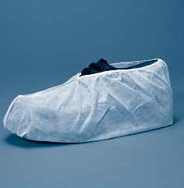
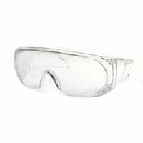
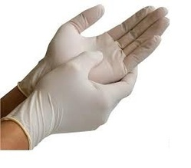



Slide 15
Procedures :
Microbiological cultures (bacteria, viruses, parasites, and fungi) must be labelled correctly and stored securely.
Benches and equipment must be disinfected before and after use.
No mouth pipetting. Use mechanical pipetting devices.
Cracked glassware should not be used. Do not place hot glassware in water, rapid cooling may make it shatter.
Make sure all chemicals are clearly and currently labelled with the substance name, concentration, date, and name of the individual responsible.
Contaminated liquids must be decontaminated (chemically or physically) before discharge to the sink.

Slide 16
Procedures :
In the lab, waste must be contained in a biohazard box with an autoclavable biohazard bag (usually yellow) .
Sterilize solids by autoclaving, then transfer into a different bag to indicate that the waste has been deactivated.
All procedures should be performed in a way that minimizes the formation of aerosols and droplets.
All spills, accidents and exposures to infectious materials must be reported to the laboratory supervisor.
The laboratory should be kept neat, clean and free of materials that are not pertinent to the work.
Work surfaces must be decontaminated after any spill and at the end of the day.

Slide 17
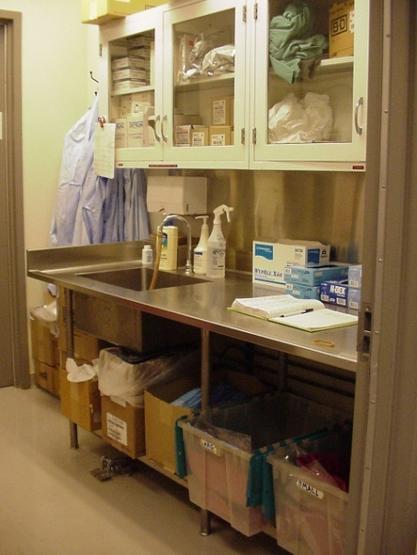
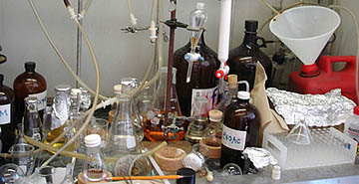
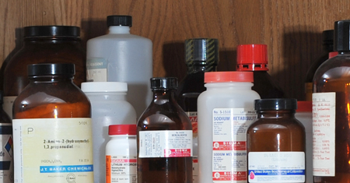
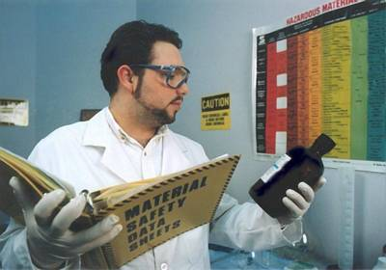

Slide 18
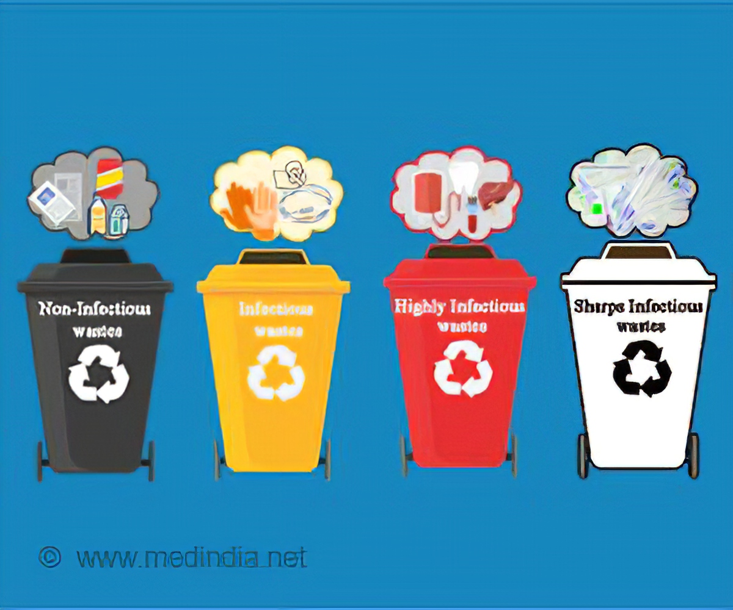


Slide 19
Collection, transportation and submission of samples for laboratory diagnosis
Before the laboratory investigation is under taken, a complete case history should be submitted to help laboratory staff to decide on the range of possible agents, to select the most appropriate tests.
General guide lines in collection, transportation and diagnosis of samples :
1- Samples should be taken from living or recently dead animals.
2- Samples should be taken from the effected site as early as possible especially in viral diseases because shedding of virus is usually maximal in the early infection.

Slide 20
3- Samples should be taken from the edge of lesions because microbial replication will be most active at the lesion's edge.
4- Samples should be collected before the administration of any form of treatments.
5- Collect samples aseptically as possible because the relevant pathogens may be overgrown by the contaminating bacteria.
6- Samples should be submitted individually in separate water-tight containers, screw capped jars.
7- Samples should be clearly marked indicating the tissue, animal and the date of collection.
8- If transportation to the laboratory is delayed, the sample should be refrigerated at 4°C and not frozen.
9- For complete diagnosis, the samples should be submitted to microbiological, pathological, serological, hematological and biochemical tests.

